Slide 1
Chapter 04
Distributions and
Hypothesis Testing

Slide 2
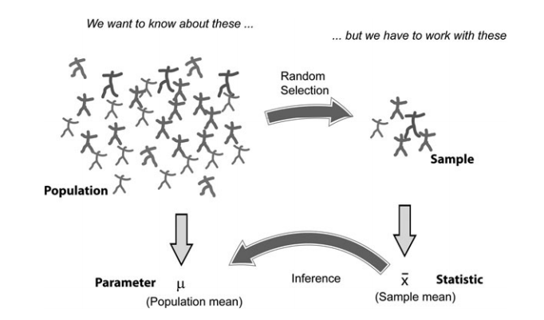
Background

Slide 3
Background
Population : Includes all of the elements from a set of data.
Sample ：Consists of one or more observations from the population

Slide 4
Background
Parameter : Characteristic of a population, such as a mean or standard deviation. Often notated using Greek letters.
Statistic : A measurable characteristic of a sample.
Examples of statistics are:
the mean value of the sample data
the range of the sample data
deviation of the data from the sample mean

Slide 5
Sample statistics versus population parameters
Measure | Population Parameter | Sample Statistic
Mean
Variance
Standard Deviation

Slide 6
Background
Sampling distribution : The probability distribution of a given statistic based on a random sample.
Statistical inference : Enables you to make an educated guess about a population parameter based on a statistic computed from a sample randomly drawn from that population.

Slide 7
Measures of Central Tendency:
Central Tendency
Arithmetic Mean
Median
Mode
Middle value in the ordered array
Most frequently observed value

Slide 8
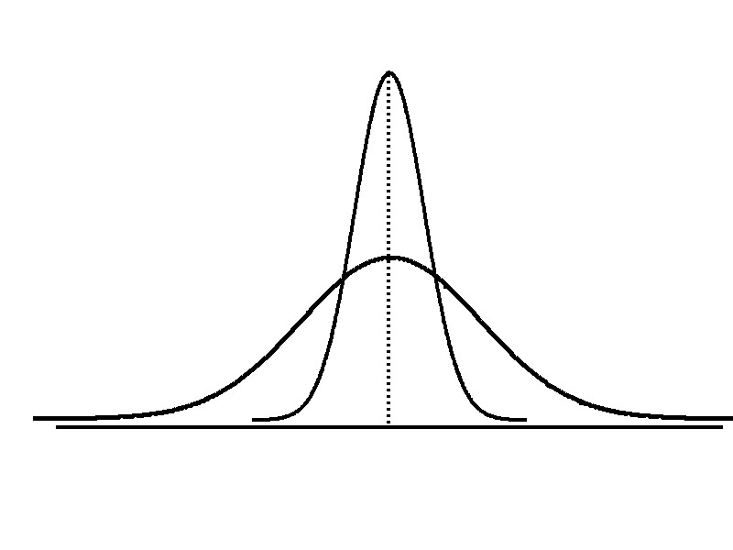
Measures of Variation
Variation
Range
Variance
Standard Deviation
Coefficient of Variation
X_{largest} – X_{smallest}
Measures of variation give information on the spread or variability or dispersion of the data values.
Same center,
different variation

Slide 9
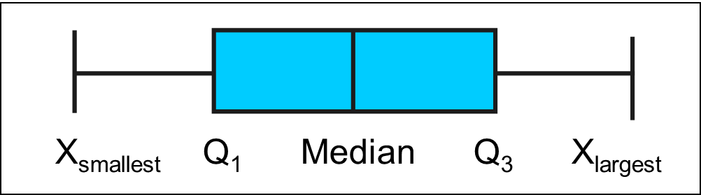
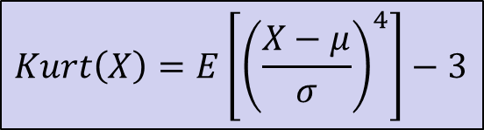
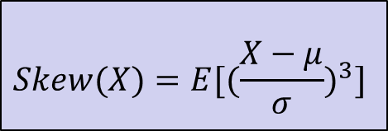
Shape of a Distribution
Shape
Skewness
Kurtosis
Boxplot
$$Skew(X)=E[{(\frac{X−μ}{σ})}^{3}]$$
$$Kurt\left(X\right)=E\left[{\left(\frac{X−μ}{σ}\right)}^{4}\right]−3$$

Slide 10
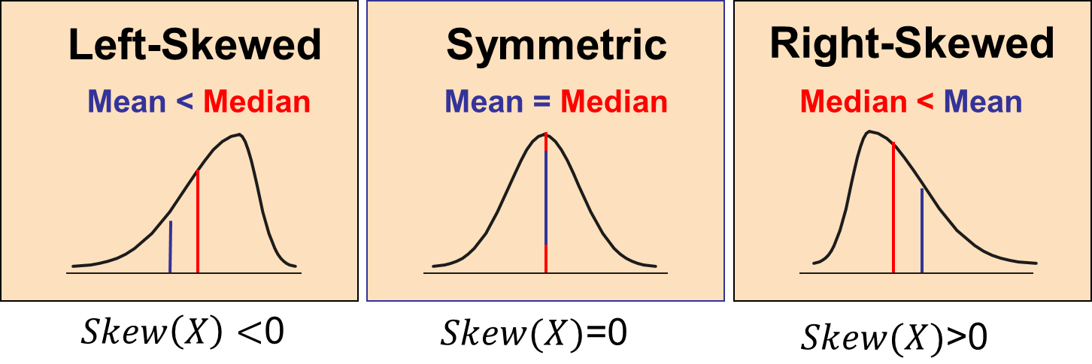
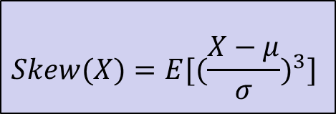
Shape of a Distribution
Shape
$$Skew(X)=E[{(\frac{X−μ}{σ})}^{3}]$$
Skewness

Slide 11
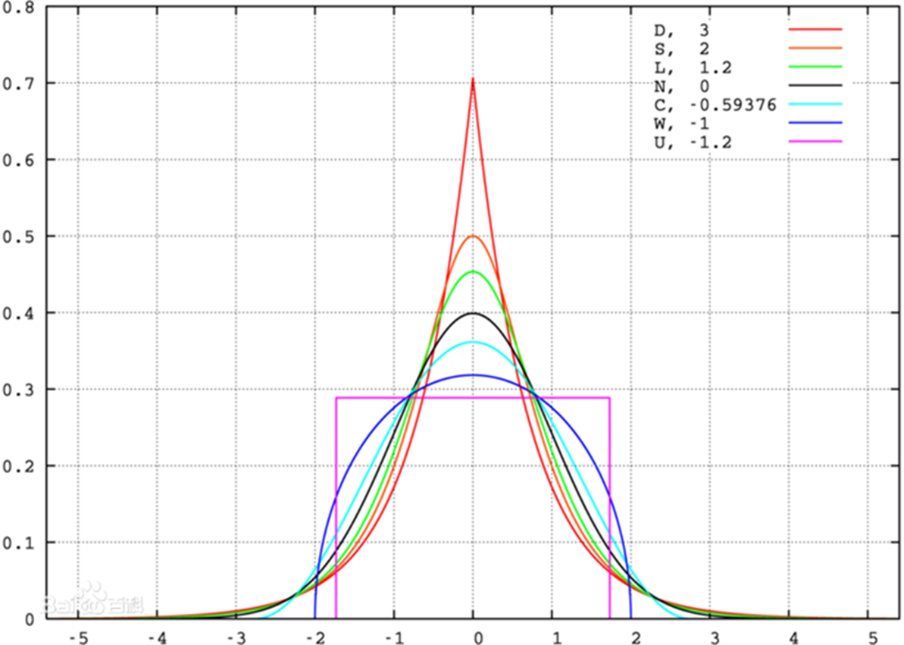
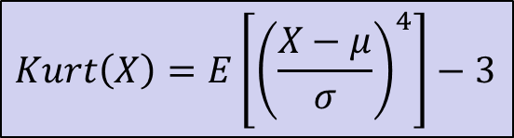
Shape of a Distribution
Shape
Kurtosis
$$Kurt\left(X\right)=E\left[{\left(\frac{X−μ}{σ}\right)}^{4}\right]−3$$
Mesokurtic distributions
Leptokurtic distributions
Platykurtic distributions

Slide 12
Shape of a Distribution
Shape
The Boxplot: A Graphical display of the data based on the five-number summary:
Boxplot
X_{smallest} -- Q₁ -- Median -- Q₃ -- X_{largest}
Example:
25% of data 25% 25% 25% of data
of data of data
X_{smallest} Q₁ Median Q₃ X_{largest}

Slide 13
Shape of a Distribution
Shape
Boxplot
Left-Skewed
Symmetric
Right-Skewed
Q₁
Q₂
Q₃
Q₁
Q₂
Q₃
Q₁
Q₂
Q₃

Slide 14
Hypothesis Testing

Slide 15

The Lady Testing Tea
R.A. Fisher was one of the founding fathers of modern statistics.
One of his early experiments, and perhaps the most famous, was to test an English lady’s claim that she could tell whether milk was poured before tea or not.
The story is so famous that it was named after a popular book on statistics by Salsburg – The Lady Testing Tea: How Statistics Revolutionized Science in the Twentieth Century

Slide 16
The Lady Testing Tea
At Rothamstead in England, Fisher make a cup of tea for Muriel Bristol, but Bristol said she preferred to pour milk into the cup first, and then the tea. This lady claims that she is able to tell the difference between pouring tea or milk first.
Fisher, the founder of experimental design, certainly wanted to test whether this lady’s sense of taste was that acute. He want to test whether the following statement is acceptable:
He prepared 10 cups of mixed milk tea (in both order) for the lady to test. However, the lady has identified the order of each cup correctly.
Hypothesis H: The lady don’t has the ability to test tea

Slide 17
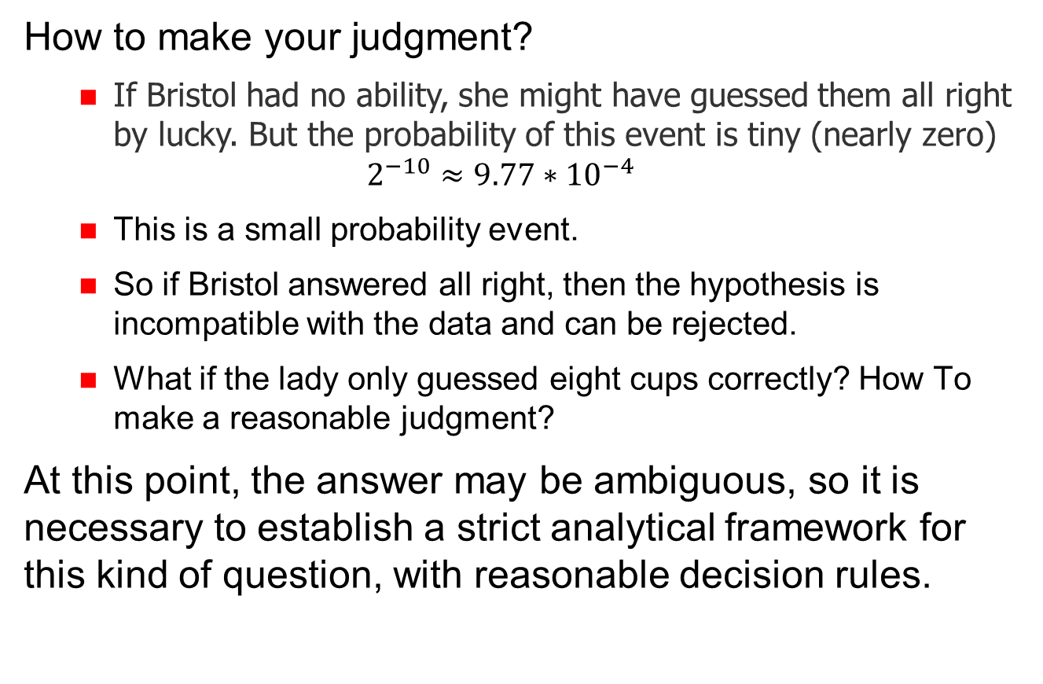
The Lady Testing Tea

Slide 18
What is a Hypothesis?
Hypothesis testing is a statistical method that is used in making statistical decisions using experimental data

Slide 19
Why do we use Hypothesis?
Hypothesis testing is an essential procedure in statistics.
A hypothesis testing evaluates two mutually exclusive statements about a population to determine which statement is best supported by the sample data.
When we say that a finding is statistically significant, it’s thanks to a hypothesis testing.

Slide 20
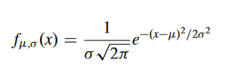
Normal Distribution
The Normal distribution or Gaussian distribution is by far the most important of all the distribution
The mean, median and mode are exactly the same.
The distribution is symmetric about the mean—half the values fall below the mean and half above the mean.
The distribution can be described by two values: the mean and the standard deviation.

Slide 21
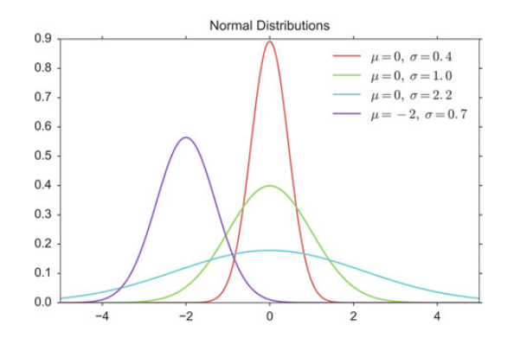
Normal Distribution

Slide 22
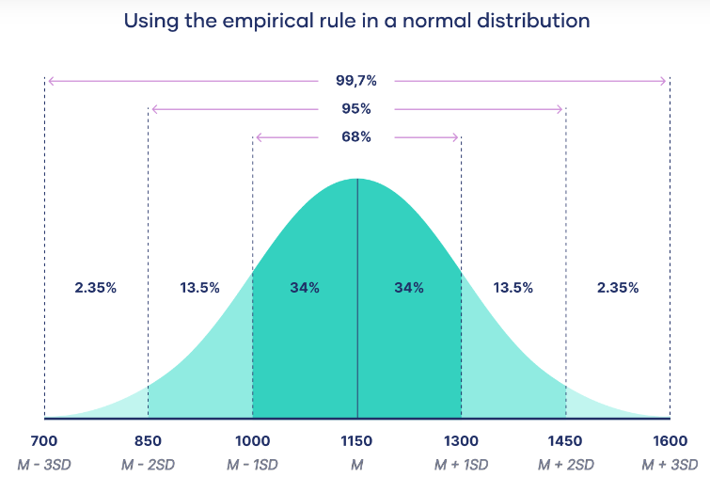
Normal Distribution

Slide 23

Central limit theorem
The central limit theorem is the basis for how normal distributions work in statistics.
Law of Large Numbers: As you increase sample size (or the number of samples), then the sample mean will approach the population mean.
With multiple large samples, the sampling distribution of the mean is normally distributed, even if your original variable is not normally distributed.
$$\overline{X}\sim N(μ,σ^{2}/n)$$

Slide 24
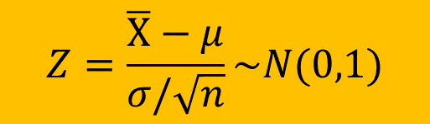
Z-Distribution
The standard normal distribution, also called the z-distribution, is a special normal distribution where the mean is 0 and the standard deviation is 1.
$$Z=\frac{\overline{X}−μ}{σ/\sqrt{n}}\sim N(0,1)$$

Slide 25
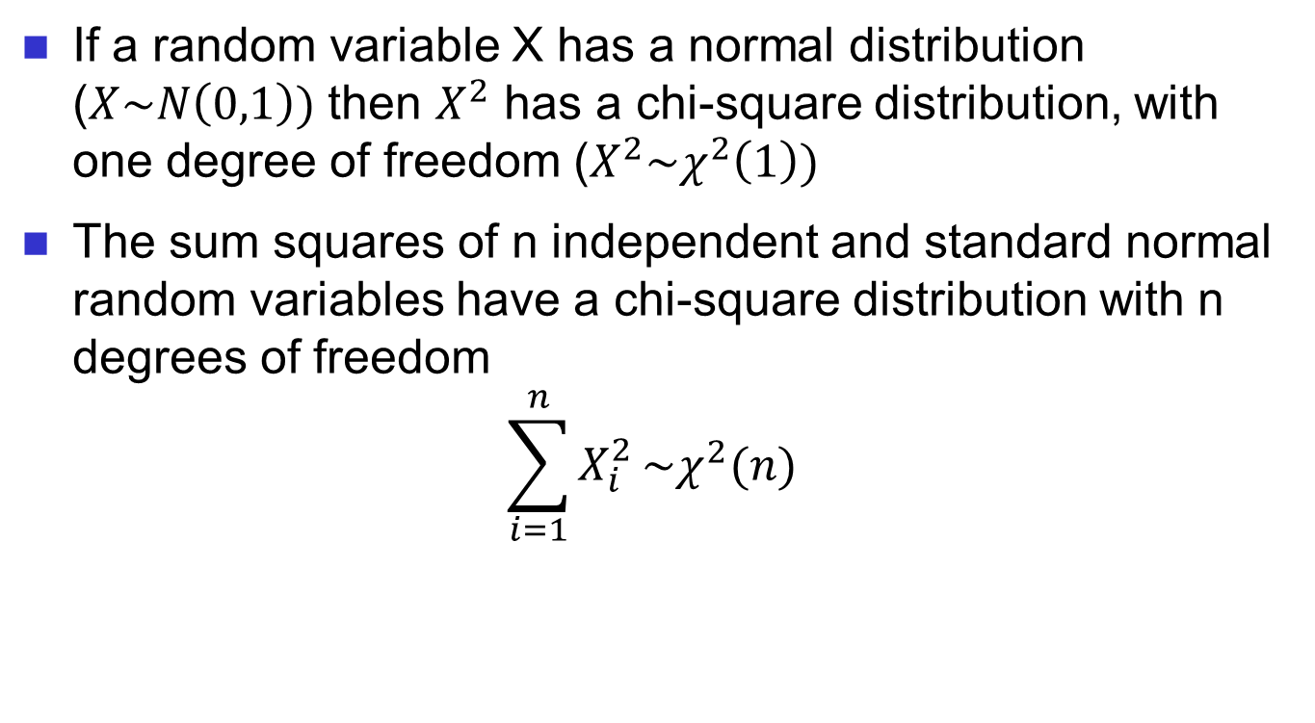

Chi-Square ($χ^{2}$) Distributions
If a random variable X has a normal distribution ($X\sim N\left(0,1\right))$ then $X^{2}$ has a chi-square distribution, with one degree of freedom ($X^{2}\sim χ^{2}\left(1\right))$
The sum squares of n independent and standard normal random variables have a chi-square distribution with n degrees of freedom
$$\sum_{i=1}^{n}{X_{i}^{2}}\sim χ^{2}(n)$$

Slide 26
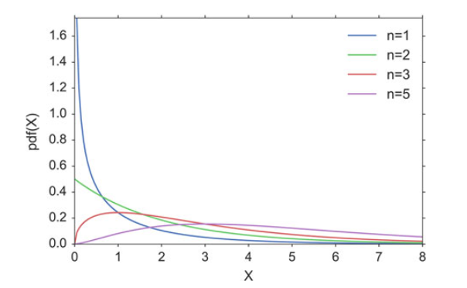
Chi-Square ($χ^{2}$) Distributions
As n increases, the distribution looks more and more similar to a normal distribution. In fact, when n is 90 or greater, a normal distribution is a good approximation of the chi-square distribution.

Slide 27

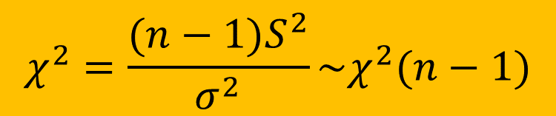
Chi-Square ($χ^{2}$) Distributions
Test statistics
$$S^{2}=\frac{\sum_{i=1}^{n}{{\left(X_{i}−\overline{X}\right)}^{2}}}{n−1}$$
$$χ^{2}=\frac{(n−1)S^{2}}{σ^{2}}\sim χ^{2}(n−1)$$

Slide 28
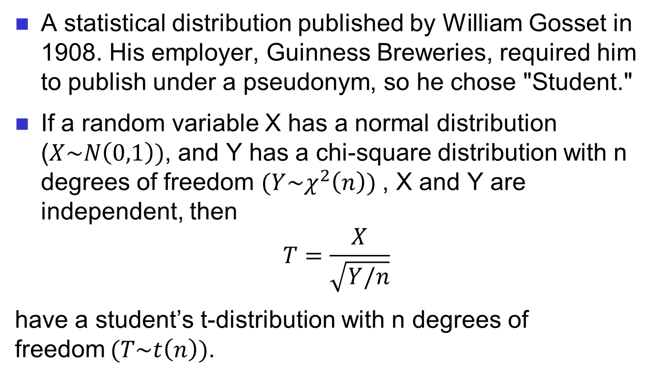
Student’s t-distribution
A statistical distribution published by William Gosset in 1908. His employer, Guinness Breweries, required him to publish under a pseudonym, so he chose "Student."
If a random variable X has a normal distribution ($X\sim N\left(0,1\right))$, and Y has a chi-square distribution with n degrees of freedom $(Y\sim χ^{2}\left(n\right))$ , X and Y are independent, then
$$T=\frac{X}{\sqrt{Y/n}}$$
have a student’s t-distribution with n degrees of freedom$(T\sim t\left(n\right))$.

Slide 29
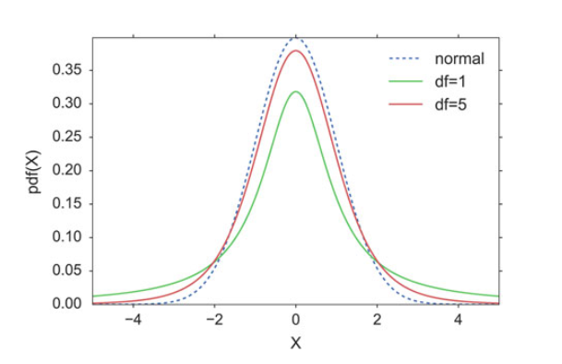
Student’s t-distribution
Since the t-distribution has longer tails than the normal distribution, it is much less affected by extreme cases

Slide 30
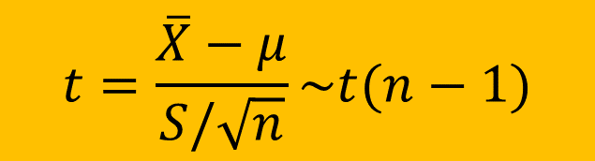

Student’s t-distribution
Test Statistics
Student's t-distribution is defined as the distribution of the random variable t which is (very loosely) the "best" that we can do not knowing $σ$.
$$t=\frac{\overline{X}−μ}{S/\sqrt{n}}\sim t(n−1)$$

Slide 31
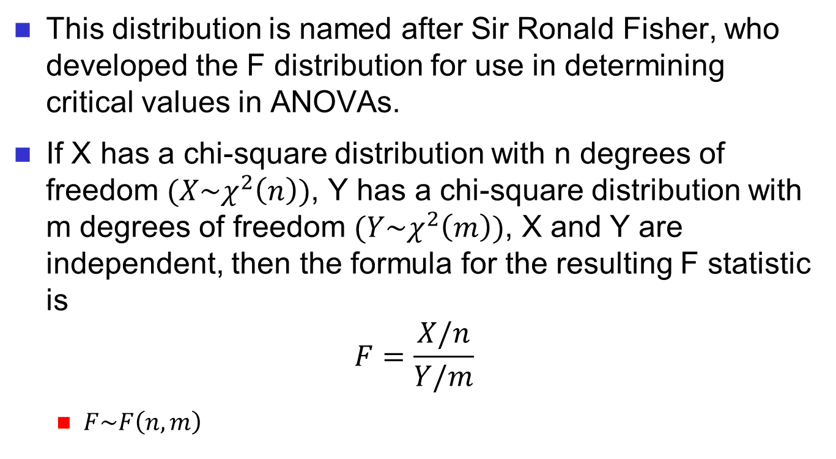
F-Distribution
This distribution is named after Sir Ronald Fisher, who developed the F distribution for use in determining critical values in ANOVAs.
If X has a chi-square distribution with n degrees of freedom $(X\sim χ^{2}\left(n\right))$, Y has a chi-square distribution with m degrees of freedom $(Y\sim χ^{2}\left(m\right))$, X and Y are independent, then the formula for the resulting F statistic is
$$F=\frac{X/n}{Y/m}$$
$F\sim F\left(n,m\right)$

Slide 32
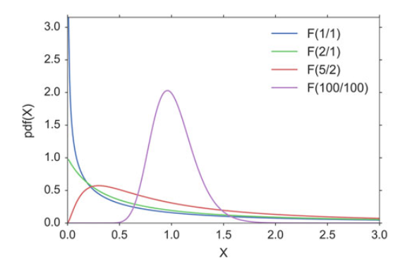
F-Distribution

Slide 33
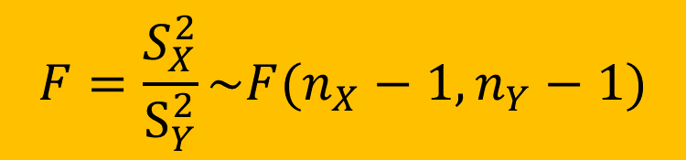
F-Distribution
Test Statistics
If we want to investigate whether two groups have the same variance, we have to calculate the ratio of the sample standard deviations squared:
$$F=\frac{S_{X}^{2}}{S_{Y}^{2}}\sim F(n_{X}−1,n_{Y}−1)$$

Slide 34
Parametric and Nonparametric Statistical Hypothesis Tests
Parametric statistical methods assume that the data has a known and specific distribution, often a Gaussian distribution.
If a data sample is not Gaussian, then the assumptions of parametric statistical tests are violated and nonparametric statistical methods must be used.

Slide 35
Parametric Statistical Hypothesis Tests
A hypothesis is basically a
claim (assertion) about a
population parameter:
population mean
population proportion
Example: The mean monthly cell phone bill in this city is μ = $42
Example: The proportion of adults in this city with cell phones is π = 0.68

Slide 36
The Null Hypothesis, H₀
States the claim or assertion to be tested
Example: The average number of TV sets in
U.S. Homes is equal to three ( )
Is always about a population parameter, not about a sample statistic

Slide 37
The Null Hypothesis, H₀
(continued)
Begin with the assumption that the null hypothesis is true
Similar to the notion of innocent until proven guilty
Refers to the status quo or historical value
Always contains “=” , “≤” or “≥” sign
May or may not be rejected

Slide 38
The Alternative Hypothesis, H₁
Is the opposite of the null hypothesis
e.g., The average number of TV sets in U.S. homes is not equal to 3 ( H₁: μ ≠ 3 )
Challenges the status quo
May contains the “=” , “≤” or “≥” sign
May or may not be proven
Is generally the hypothesis that the researcher is trying to prove

Slide 39
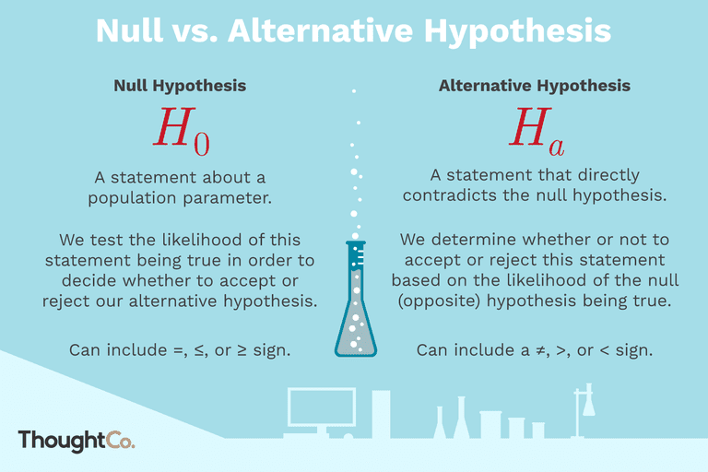
H₀ vs. H₁

Slide 40
The Hypothesis Testing Process
Claim: The population mean age is 50.
H₀: μ = 50, H₁: μ ≠ 50
Sample the population and find sample mean.
Population
Sample

Slide 41
The Hypothesis Testing Process
(continued)
Suppose the sample mean age was X = 20.
This is significantly lower than the claimed mean population age of 50.
If the null hypothesis were true, the probability of getting such a different sample mean would be very small, so you reject the null hypothesis .
In other words, getting a sample mean of 20 is so unlikely if the population mean was 50, you conclude that the population mean must not be 50.

Slide 42
The Hypothesis Testing Process
(continued)
Sampling Distribution of X
X
20
μ = 50
If H₀ is true
... then you reject the null hypothesis that μ = 50.
If it is unlikely that you would get a sample mean of this value ...
... When in fact this were the population mean…

Slide 43
The Test Statistic and Critical Values
If the sample mean is close to the assumed population mean, the null hypothesis is not rejected.
If the sample mean is far from the assumed population mean, the null hypothesis is rejected.
How far is “far enough” to reject H₀?
The critical value of a test statistic creates a “line in the sand” for decision making -- it answers the question of how far is far enough.

Slide 44
The Test Statistic and Critical Values
Sampling Distribution of the test statistic
Region of Rejection
Region of Rejection
Region of
Non-Rejection
Critical Values
“Too Far Away” From Mean of Sampling Distribution

Slide 45
Possible Errors in Hypothesis Test Decision Making
Type I Error
Reject a true null hypothesis
Considered a serious type of error
The probability of a Type I Error is α
Called level of significance of the test
Set by researcher in advance
Type II Error
Failure to reject false null hypothesis
The probability of a Type II Error is β

Slide 46
Possible Errors in Hypothesis Test Decision Making
(continued)
Possible Hypothesis Test Outcomes
 | Actual Situation
Decision | H₀ True | H₀ False
Do Not Reject H₀ | No Error Probability 1 - α | Type II Error Probability β
Reject H₀ | Type I Error Probability α | No Error Probability 1 - β

Slide 47
Possible Results in Hypothesis Test Decision Making
(continued)
The confidence coefficient (1-α) is the probability of not rejecting H₀ when it is true.
The confidence level of a hypothesis test is (1-α)*100%.
The power of a statistical test (1-β) is the probability of rejecting H₀ when it is false.

Slide 48
Type I & II Error Relationship
Type I and Type II errors cannot happen at
the same time
A Type I error can only occur if H₀ is true
A Type II error can only occur if H₀ is false

Slide 49
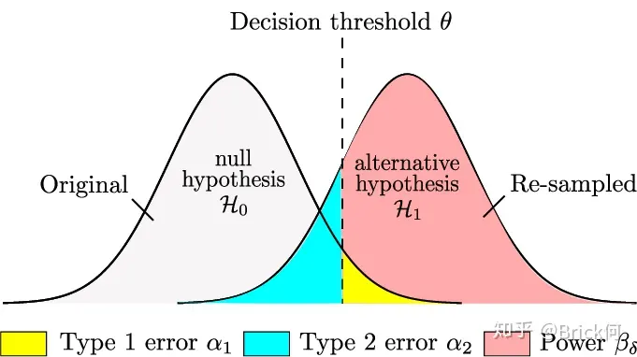


Type I & II Error Relationship
If Type I error probability ( α ) , then
Type II error probability ( β )
$α$
$$β$$

Slide 50
Factors Affecting Type II Error
All else equal,
β when the difference between hypothesized parameter and its true value
β when α
β when σ
β when n

Slide 51


Level of Significance and the Rejection Region
H₀: μ = 3 H₁: μ ≠ 3
Level of significance =
α
$$a/2$$
$$1−a/2$$
0
Critical values
Rejection Region
This is a two-tail test because there is a rejection region in both tails

Slide 52
One-Tail Tests
In many cases, the alternative hypothesis focuses on a particular direction
This is a lower-tail test since the alternative hypothesis is focused on the lower tail below the mean of 3
H₀: μ ≥ 3
H₁: μ < 3
H₀: μ ≤ 3
H₁: μ > 3
This is an upper-tail test since the alternative hypothesis is focused on the upper tail above the mean of 3

Slide 53
Lower-Tail Tests
H₀: μ ≥ 3
H₁: μ < 3
There is only one critical value, since the rejection area is in only one tail
α
Reject H₀
Do not reject H₀
Z or t
-Z_{α} or -t_{α}
0
μ
X
Critical value

Slide 54
Upper-Tail Tests
H₀: μ ≤ 3
H₁: μ > 3
There is only one critical value, since the rejection area is in only one tail
α
Z or t
Do not reject H₀
Reject H₀
0
Z_{α} or t_{α}
_
X
μ
Critical value

Slide 55
p-Value Approach to Testing
p-value: Probability of obtaining a test statistic equal to or more extreme than the observed sample value given H₀ is true
The p-value is also called the observed level of significance
It is the smallest value of α for which H₀ can be rejected

Slide 56
p-Value Approach to Testing: Interpreting the p-value
Compare the p-value with α
If p-value < α , reject H₀
If p-value ≥ α , do not reject H₀
Remember
If the p-value is low then H₀ must go

Slide 57
Hypothesis Tests for the Mean
Hypothesis
Tests for μ
σ Known
σ Unknown
(Z test)
(t test)

Slide 58
Z Test of Hypothesis for the Mean (σ Known)
Convert sample statistic ( ) to a Z_{STAT} test statistic
X
Hypothesis
Tests for μ
σ Known
σ Known
σ Unknown
σ Unknown
(Z test)
(t test)
The test statistic is:

Slide 59
The 5 Step p-value approach to Hypothesis Testing
State the null hypothesis, H₀ and the alternative hypothesis, H₁
Choose the level of significance, α, and the sample size, n
Determine the appropriate test statistic and sampling distribution
Collect data and compute the value of the test statistic and the p-value
Make the statistical decision and state the managerial conclusion. If the p-value < α then reject H₀, otherwise do not reject H₀. State the managerial conclusion in the context of the problem

Slide 60
p-value Hypothesis Testing Example
Test the claim that the true mean of TV sets in US homes is equal to 3.
(Assume σ = 0.8)
1. State the appropriate null and alternative
hypotheses
H₀: μ = 3 H₁: μ ≠ 3 (This is a two-tail test)
2. Specify the desired level of significance and the sample size
Suppose that α = 0.05 and n = 100 are chosen for this test

Slide 61
p-value Hypothesis Testing Example
(continued)
3. Determine the appropriate technique
σ is assumed known so this is a Z test.
4. Collect the data, compute the test statistic and the p-value
Suppose the sample results are
n = 100, X = 2.84 (σ = 0.8 is assumed known)
So the test statistic is:

Slide 62
p-Value Hypothesis Testing Example: Calculating the p-value
4. (continued) Calculate the p-value.
How likely is it to get a Z_{STAT} of -2 (or something further from the mean (0), in either direction) if H₀ is true?
P(Z < -2.0) = 0.0228
P(Z > 2.0) = 0.0228
0
Z
-2.0
2.0
p-value = 0.0228 + 0.0228 = 0.0456

Slide 63
p-value Hypothesis Testing Example
(continued)
5. Is the p-value < α?
Since p-value = 0.0456 < α = 0.05 Reject H₀
5. (continued) State the managerial conclusion in the context of the situation.
There is sufficient evidence to conclude the average number of TVs in US homes is not equal to 3.

Slide 64
Do You Ever Truly Know σ?
Probably not!
In virtually all real world business situations, σ is not known.
If there is a situation where σ is known then µ is also known (since to calculate σ you need to know µ.)
If you truly know µ there would be no need to gather a sample to estimate it.

Slide 65
Hypothesis Testing: σ Unknown
If the population standard deviation is unknown, you instead use the sample standard deviation S.
Because of this change, you use the t distribution instead of the Z distribution to test the null hypothesis about the mean.
When using the t distribution you must assume the population you are sampling from follows a normal distribution.
All other steps, concepts, and conclusions are the same.

Slide 66
t Test of Hypothesis for the Mean (σ Unknown)
t Test of Hypothesis for the Mean (σ Unknown)
Convert sample statistic ( ) to a t_{STAT} test statistic
X
Hypothesis
Tests for μ
Hypothesis
Tests for μ
Hypothesis
Tests for μ
σ Known
σ Known
σ Known
σ Known
σ Known
σ Known
σ Unknown
σ Unknown
σ Unknown
σ Unknown
σ Unknown
σ Unknown
(Z test)
(Z test)
(Z test)
(t test)
(t test)
(t test)
The test statistic is:
The test statistic is:
The test statistic is:

Slide 67
Example: Two-Tail Test (σ Unknown)
The average cost of a hotel room in New York is said to be $295 per night. To determine if this is true, a random sample of 25 hotels is taken and resulted in an X of $297.48 and an S of $11.27. Test the appropriate hypotheses at α = 0.05.
(Assume the population distribution is normal)
H₀: μ = 295 H₁: μ ≠ 295

Slide 68
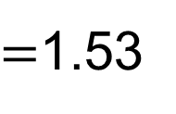
Example Solution: Two-Tail t Test
H₀: μ = 295 H₁: μ ≠ 295
α/2=.025
α/2=.025
α = 0.05
n = 50, df = 50-1=49
σ is unknown, so
use a t statistic
Critical Value:
±t_{49,0.025} = ± 2.0096
P-Value:
p-value=0.11
Reject H₀
Do not reject H₀
Reject H₀
-t _{24,0.025}
t _{24,0.025}
0
-2.0096
2.0096
1.53
Do not reject H₀: insufficient evidence that true mean cost is different than $295

Slide 69
Hypothesis Tests for the Mean
Hypothesis
Tests for μ
σ Known
σ Unknown
(Z test)
(t test)
The test statistic is:
The test statistic is:

Slide 70
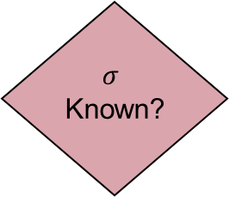
Parametric Statistical Hypothesis Tests
One-sample
procedure
Type
of
Data
Numerical
Categorical
Z test of hypothesis
for the proportion
Yes
No
Z test of hypothesis
for the mean
t test of hypothesis
for the mean

Slide 71
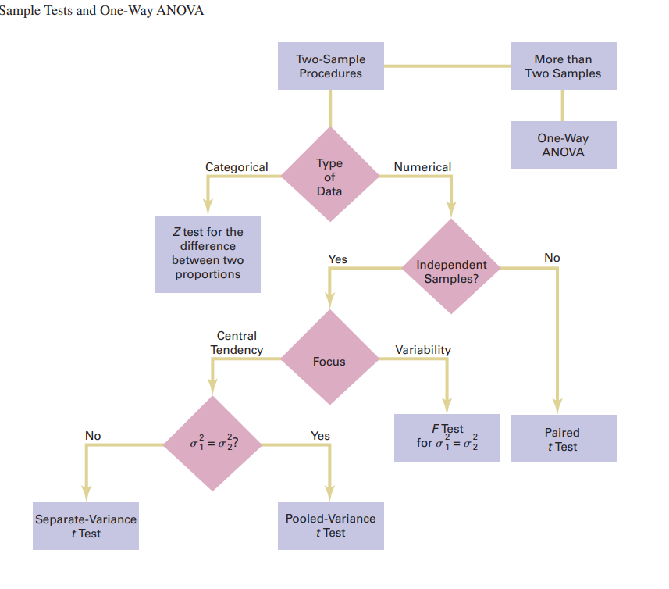

Slide 72
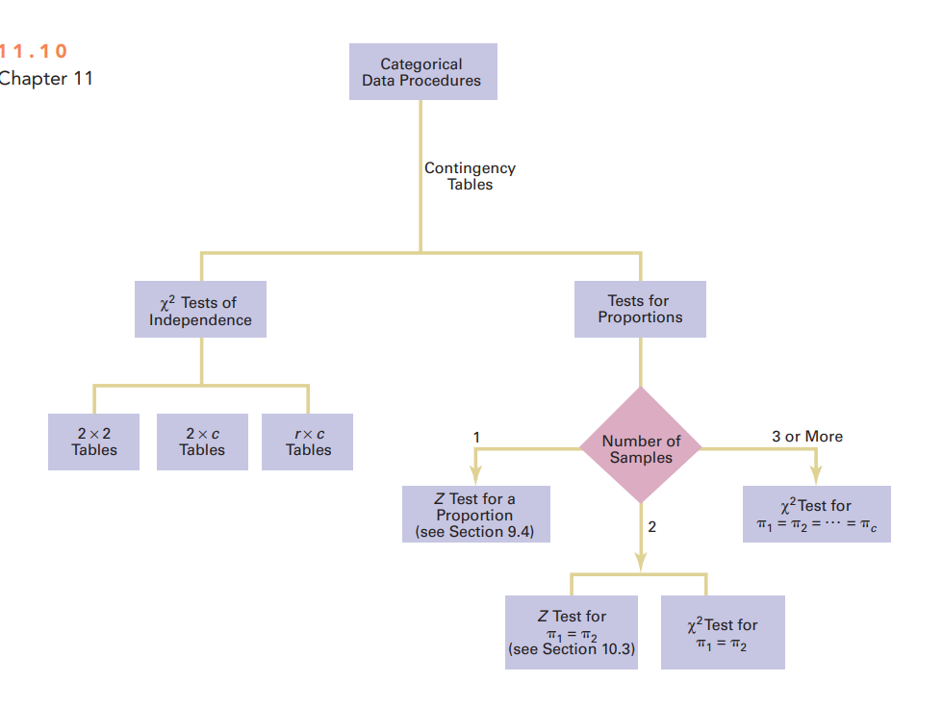

Slide 73
Normality Tests
If methods are used that assume a Gaussian distribution, and your data was drawn from a different distribution, the findings may be misleading or plain wrong.
There are a range of techniques that you can use to check if your data sample deviates from a Gaussian distribution, called normality tests.

Slide 74
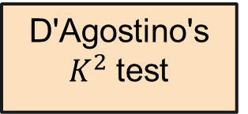
Normality Tests
Hypothesis
Tests for Normality
Graphical Methods
Statistical Normality Tests
Histogram Plot
Q-Q Plot
D'Agostino's $K^{2}$test
Shapiro-Wilk Test

Slide 75
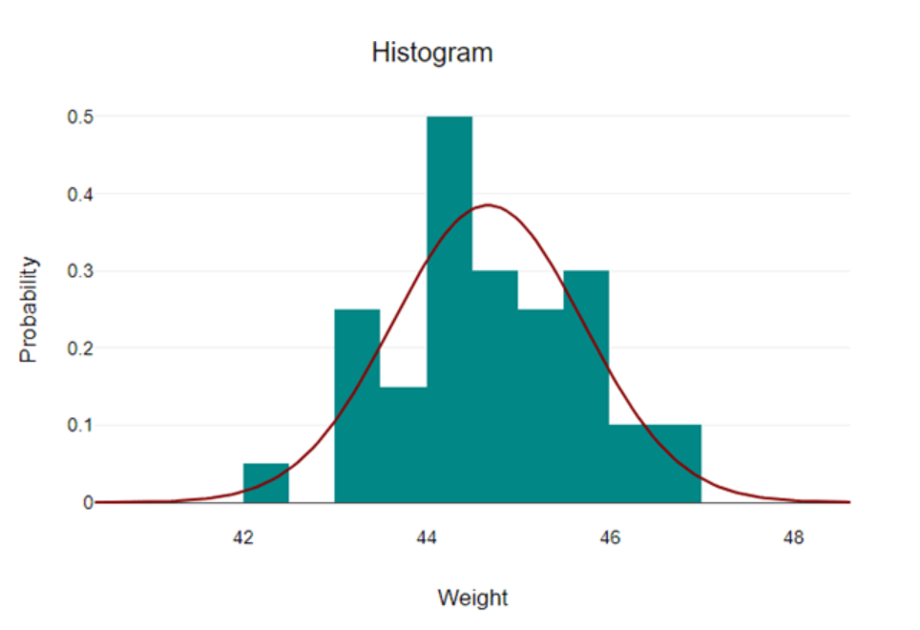
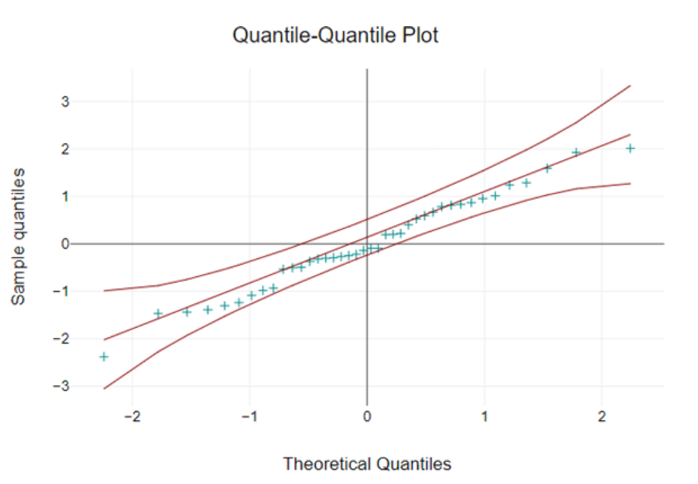
Normality Tests
Hypothesis
Tests for Normality
Graphical Methods
Histogram Plot
Q-Q Plot

Slide 76
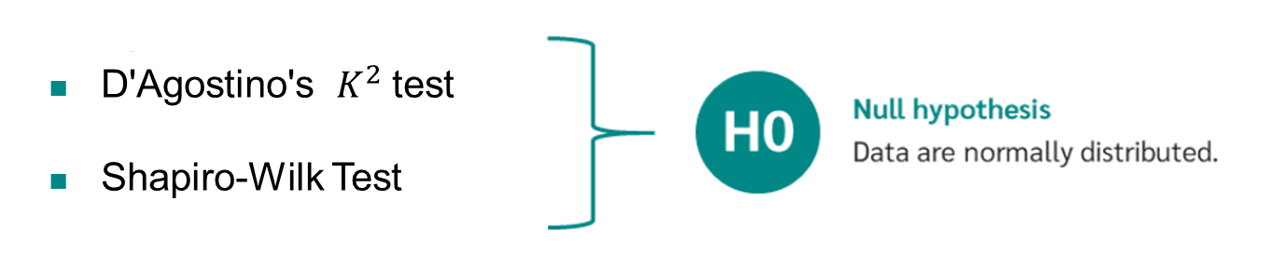
Normality Tests
Statistical Normality Tests
No
Normal distribution
is assumed
P-value smaller than 0.05
Yes
Normal distribution
is not assumed

Slide 77
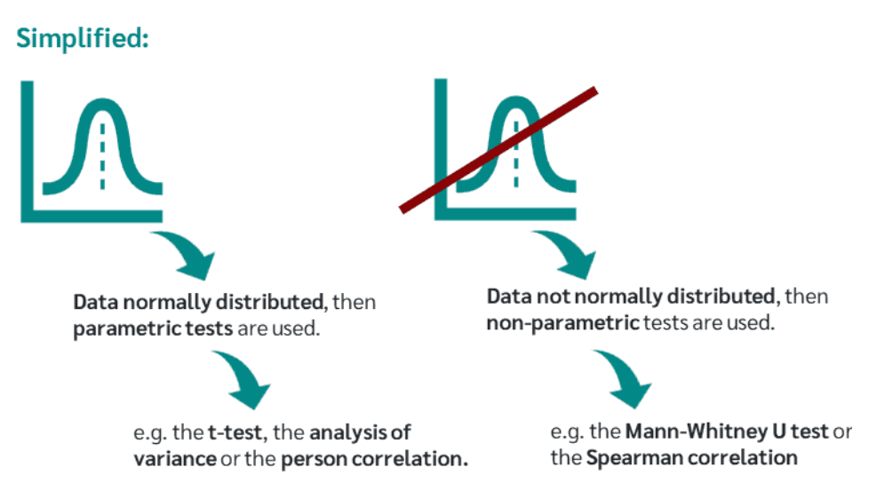
Nonparametric Statistical Hypothesis Tests

Slide 78
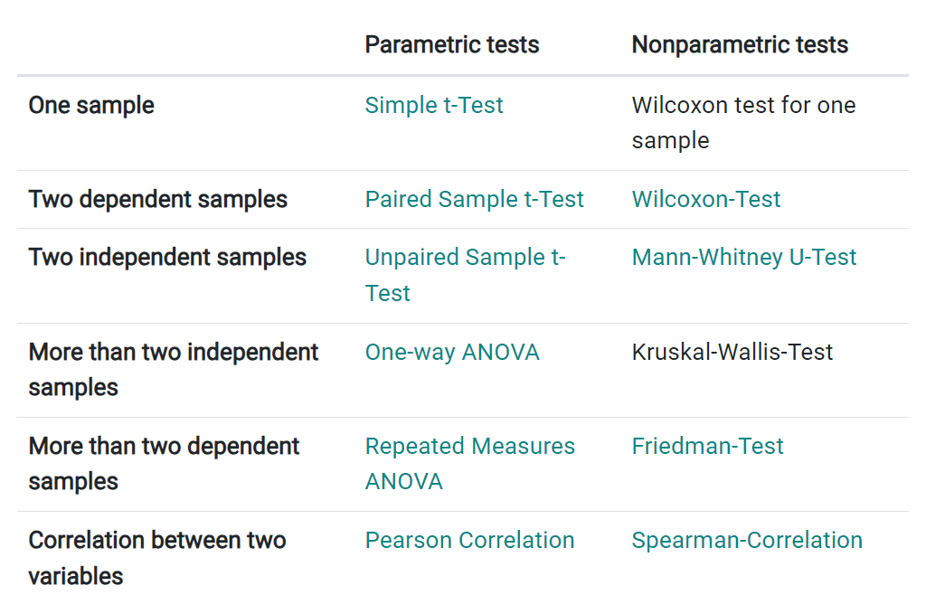
Nonparametric Statistical Hypothesis Tests

Slide 79
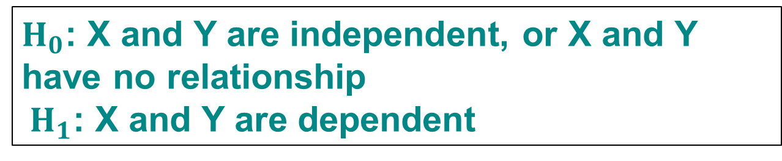
Correlation Hypothesis
Hypotheses
If there is no linear relationship in the population, then the population correlation would be equal to zero.
$H_{0}$: X and Y are independent, or X and Y have no relationship
$H_{1}$: X and Y are dependent
No
X and Y are
independent
P-value smaller than 0.05
Yes
X and Y are
dependent

Slide 80
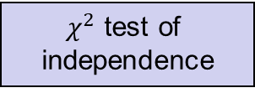
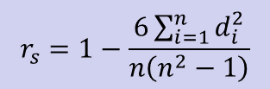
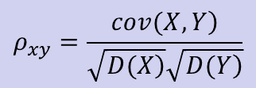
Correlation Hypothesis
One-sample
procedure
Type
of
Data
Numerical
Categorical
$χ^{2}$ test of
independence
Yes
Normal？
No
Pearson’s Correlation
Coefficient
Spearman’s Rank
Correlation
$$ρ_{xy}=\frac{\left.cov(X,Y\right)}{\sqrt{\left.D(X\right)}\sqrt{\left.D(Y\right)}}$$
$$r_{s}=1−\frac{6\sum_{i=1}^{n}{d_{i}^{2}}}{n\left(n^{2}−1\right)}$$

Slide 81
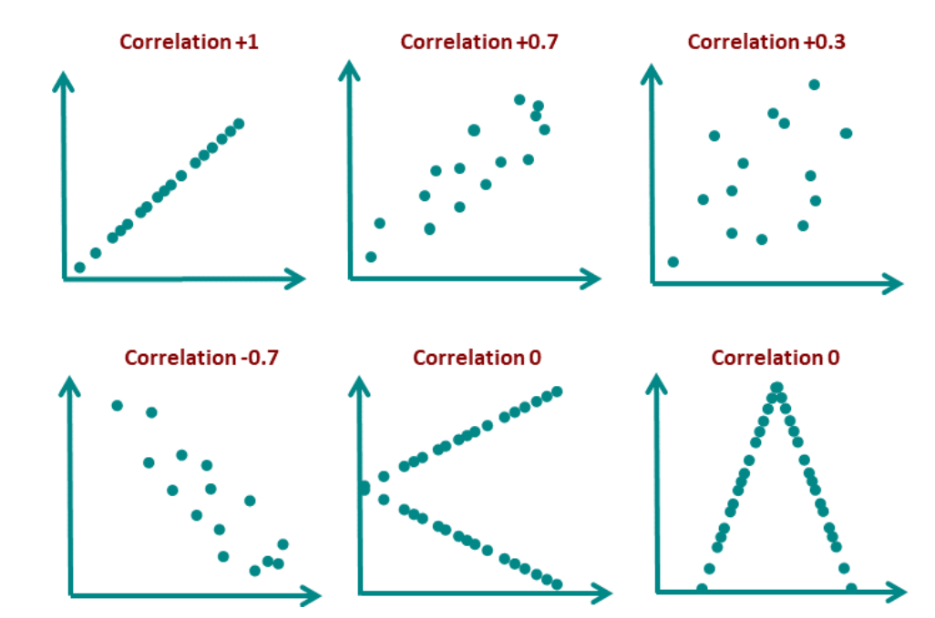
Correlation Hypothesis

